Slide 1

Engineering Excellence Cycle VII Team EETeamJ1- Service Platform
Final Presentation

Slide 2
Team
Nandini/Raghvendra(Owner)
Bhavya Agarwal(Evaluator)
Bhagyesh Choughule (Mentor)
Raghvendra Dikhit(Mentor)
Saurabh Solanki(QA Team)
Saurabh Srivastava(QA Team)
Sujala Talapula(QA Team)
Sunil Gupta(Core Development , SM)
Rakesh Singhania(Core Development)
Amit Kumar(Core Development)
Ajay Kumar(Core Development)
Hari Prasad(Core Development)
Mayank Khare(UI Development)
Sumit Chauhan(UI Development)

Slide 3
Agenda
Highlights
Features
Tools and Techniques
Architecture View
Deliverables
Demo
Code Walkthrough
Sonar Performance
Build & CI Tools & Techniques
QA Highlights
Scrum Tool
Challenges
Processes
Collective Learning
Individual Learning's

Slide 4
Case Study Highlights
Technology empowerment for ‘On Demand Economy’ business
It’s a SAAS offering
Helping to deliver better services to customers
Manages day-to-day operations of business at ease
Platform provides management of service aggregator business face on web and mobile
Empowers customer and service providers
.

Slide 5
Features
Multi-tenant web-based application.
Provides ability to register Aggregator/Tenant with Facilitator.
Transparent handling of data Isolation.
UI for Tenant management
UI for Tenant User management i.e. activate/de-activate users

Slide 6
Change Requests

Slide 7
Tools & Technologies
Context | Tools | Technology
Development Technology |  | AngularJS, HTML, CSS, Bootstrap
Scrum | Scrumdesk | http://www.scrumdesk.com/
Repository Management | Git
Document Designing | Create UML , Microsoft Word, PowerPoint
Continuous Integration | Jenkins-Cl
Build tool | apache-maven-3.2.5
Reporting UI |  | HTML, Angular JS
Login UI |  | HTML, Spring MVC 3.0
Database | SQLServer
Service Layer |  | J2EE, Amazon EC2 cloud
Server deployment |  | Apache Tomcat 7.0
Database Technology | Hibernate
Code Coverage | SonarQube
Automation, Unit test | Cucumber
IDE | Eclipse

Slide 8
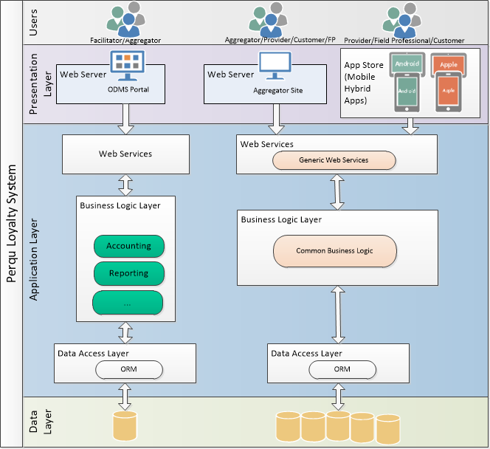
Architecture View

Slide 9
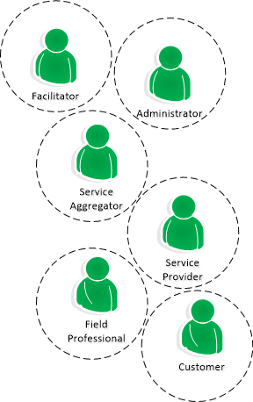
System Users

Slide 10
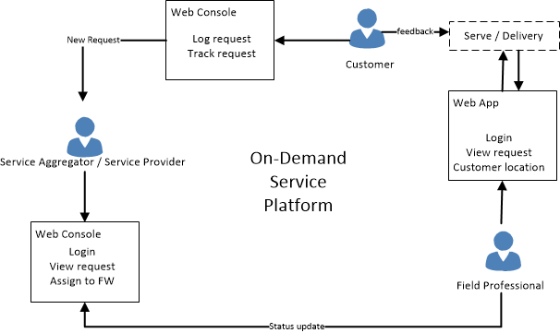
Service / Request Flow

Slide 11
Market Trends
The world is at the herald of a new era, known as the On Demand Economy.
It a surprise to know about the pace at which mobile internet is penetrating our lifestyle, and how this development is growing on every modern citizen.
‘Instant gratification’ is no longer a craze, but a lifestyle choice that every consumer with a smartphone has made.
Given that many entrepreneurs are coming up with unique ideas disrupting value chains across many established industry verticals.
Powering On Demand Businesses from the technology perspective to conceptualize di­fferent aspects of business idea.

Slide 12
Deliverables
Database design ER diagram
4+1 Solution Architecture Document
Sonar Reports
Application Deployment Document

Slide 13
Deliverables
Test Plan
Test case scenarios
Automation framework Document

Slide 14
Application Demonstration

Slide 15
Code Walkthrough

Slide 16
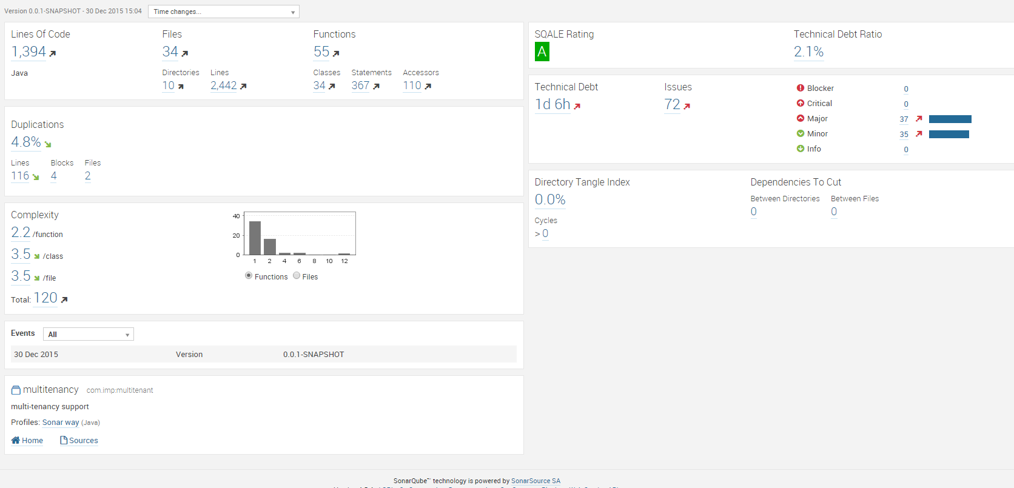
Sonar Report

Slide 17
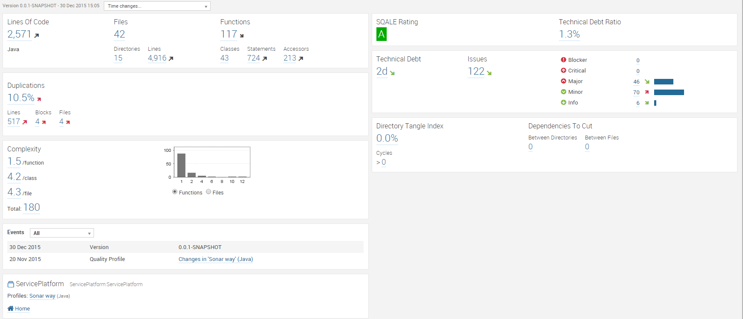
Sonar Report

Slide 18
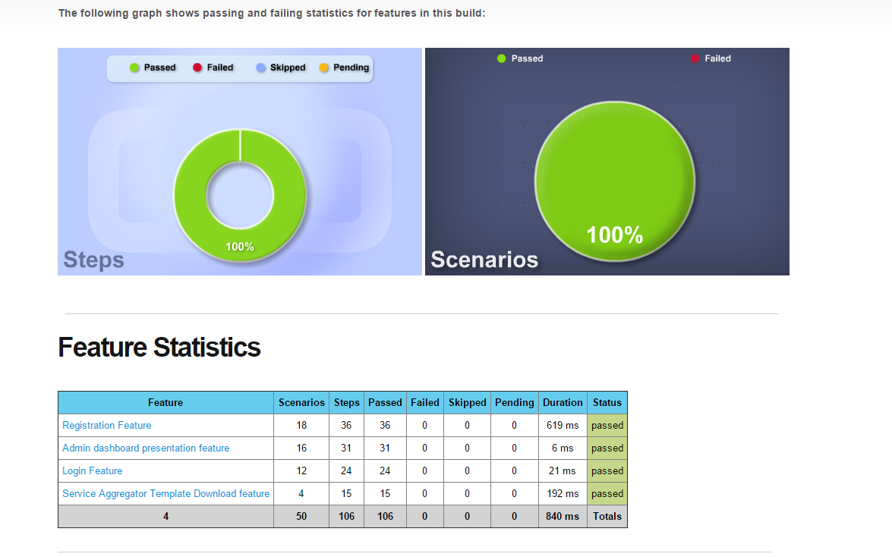
BDD Report

Slide 19
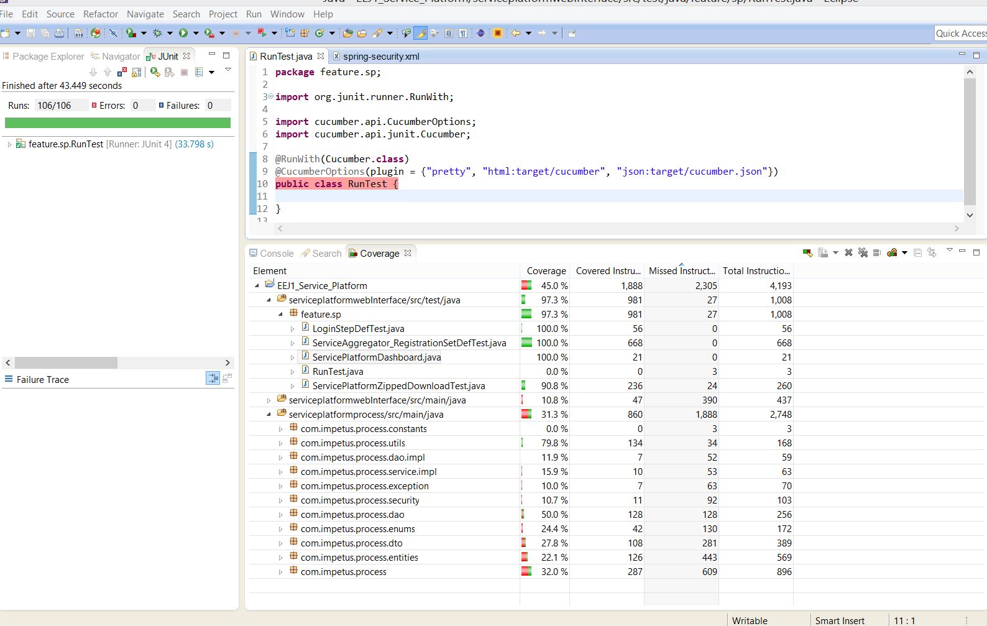
Code Coverage

Slide 20
Build & CI Tools & Techniques
Build tools
Maven 3.2.5
CI tools
Jenkins CI for App
Sonar and Cucumber plugins.
.

Slide 21
QA Highlights
QA Highlights
QA was part of requirement understanding discussions, application flow creation.
Setting up of testing process within the sprint
Feature File and Test Scenario in BBD Format
Test Plan
Covering major type of testing
Strategy for every testing type

Slide 22
QA Highlights
Test Plan
Covering major type of testing.
Strategy for every testing plan
Defined Entry/Exit Criteria
QA Policy and Test schedule
BDD Test Scenario/Test Cases
Containing BDD Test Scenario/Test cases for the functionalities implemented

Slide 23
QA Highlights
Total BDD Features File : 5
Total Number of Scenarios in each feature files
ServiceAggregator_Registration.feature :7
Service_Platform_Admin_Portal.feature:7
Service_Platform_Dashboard.feature :2
Service_Platform_Login.feature: 6
Service_Platform_Zipped_Download.feature:4
Automation
Automation framework Document

Slide 24
Area of Improvement
Improvement in right feature files in BDD format.
Customized Cucumber Report.

Slide 25
QA statics for respective sprint
Test Execution Report - Sprint 4
Test Execution Report - Sprint 5

Slide 26
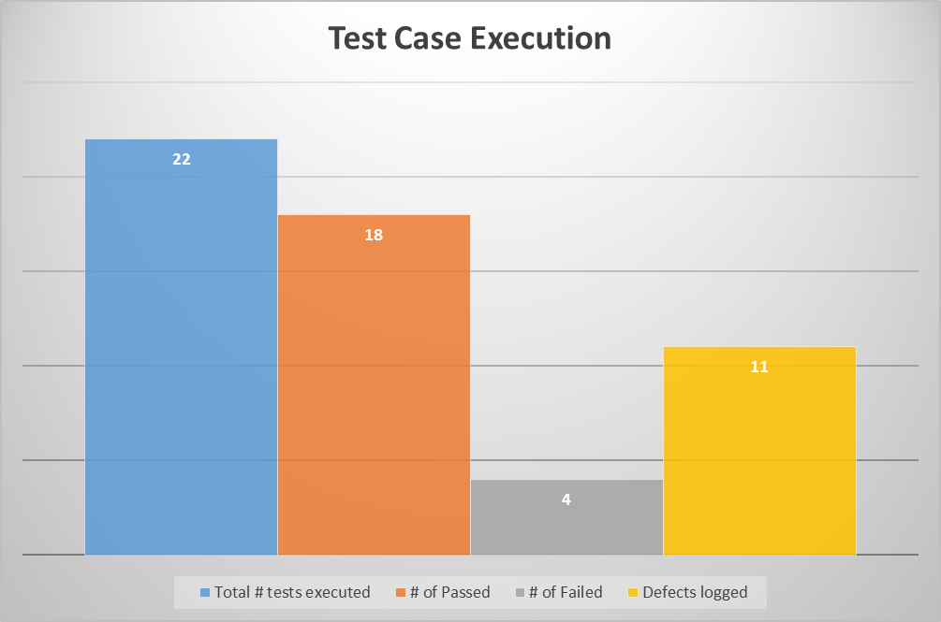
Test Execution Report : Sprint 4

Slide 27
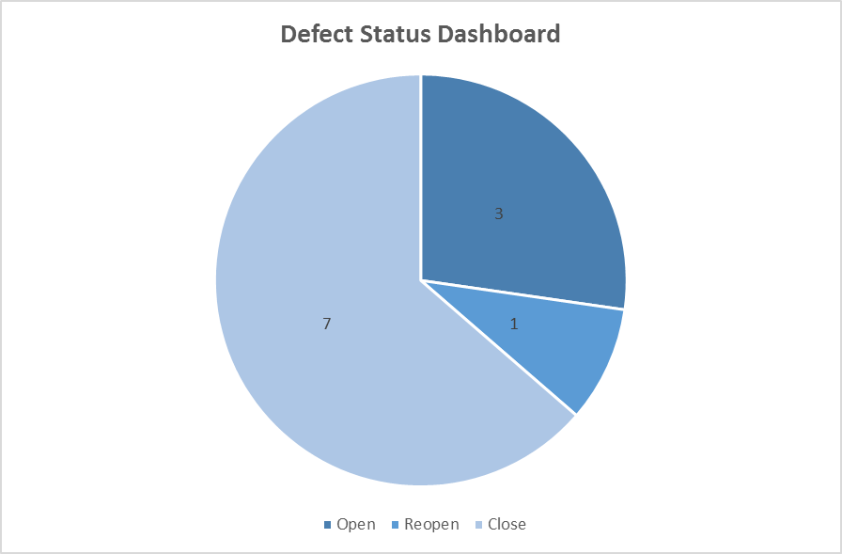
Defect Status: Sprint 4

Slide 28
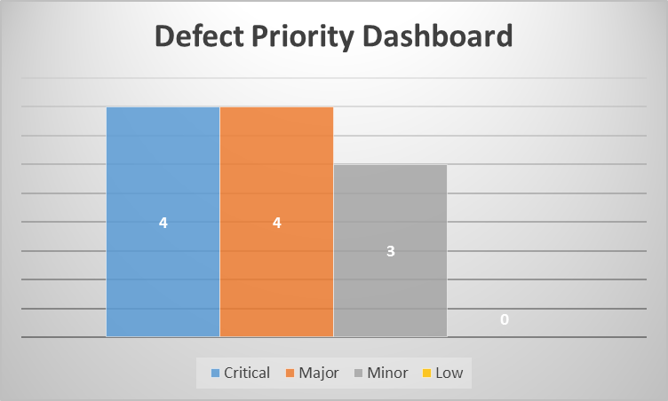
Defect Status: Sprint 4

Slide 29
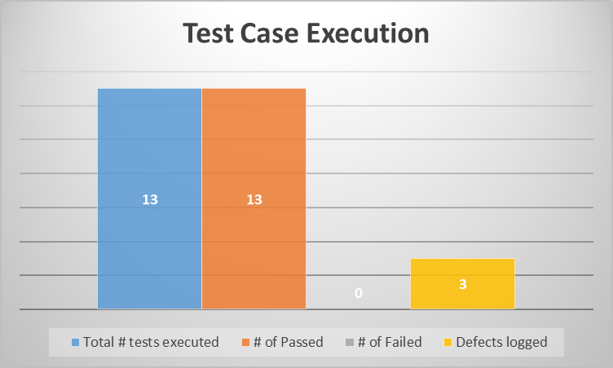
Test Execution Report : Sprint 5

Slide 30
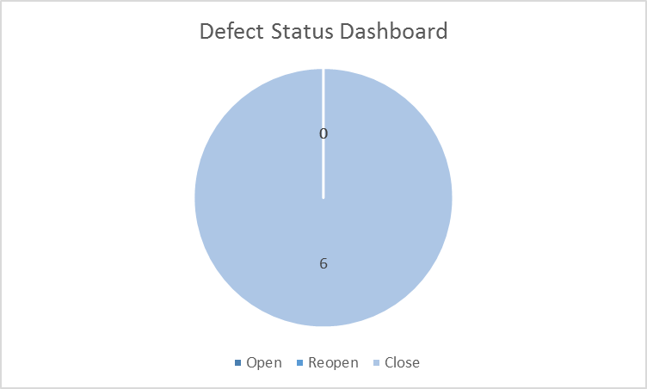
Test Execution Report : Sprint 5

Slide 31
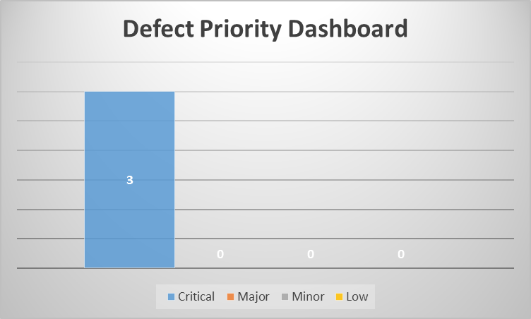
Defect Status : Sprint 5

Slide 32
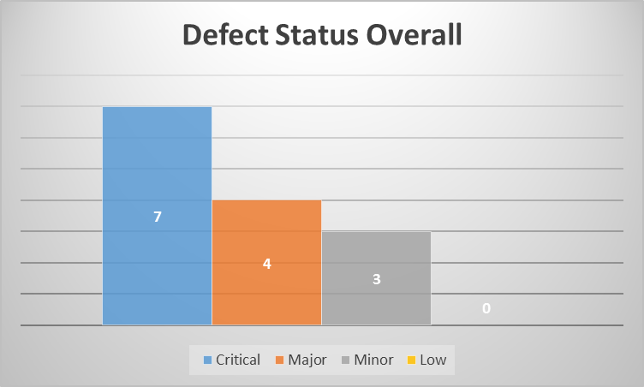
Defect Status (Overall) :

Slide 33
Project Metrics
Total Sprints = 5
User Stories = 58
Average Sprint Velocity =64

Slide 34
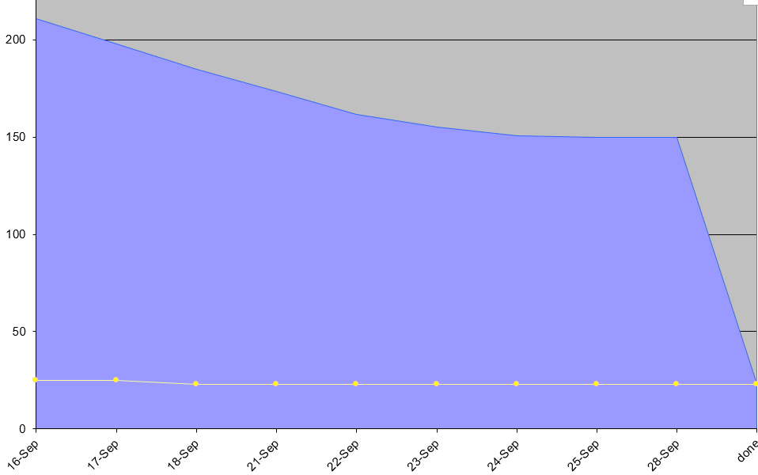
Scrum Tool – Agile Scrum Sheet
Sprint 0

Slide 35
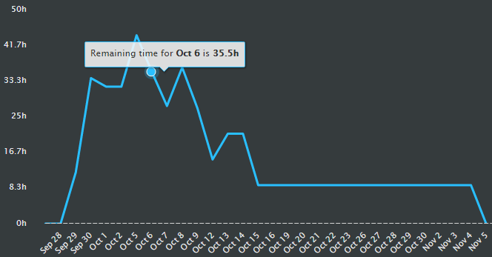
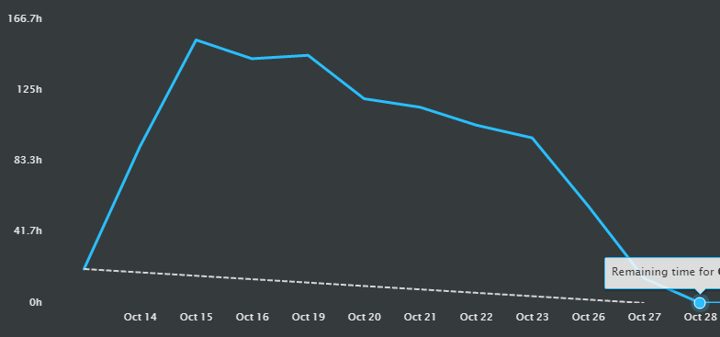
Scrum Tool – Agile Scrum Sheet
Sprint 1
Sprint 2

Slide 36
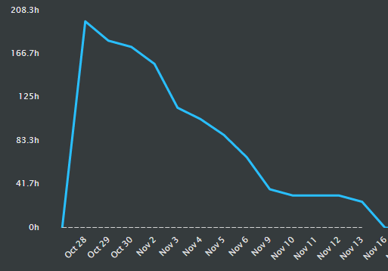
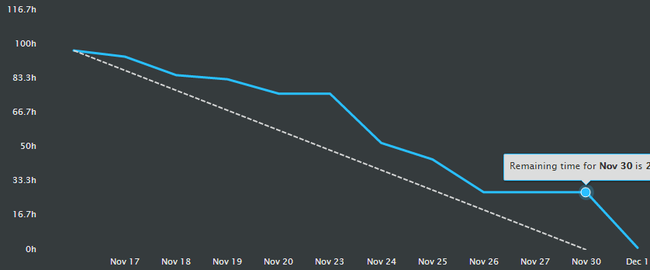
Scrum Tool – Agile Scrum Sheet
Sprint 3
Sprint 4

Slide 37
Velocity Trend

Slide 38
Challenges
Coordinating with team members from different locations.
Frequent changes in team structure at early stage of project.
Estimation and Requirement gathering
Could not estimate properly because of lack of domain understanding.
New Technologies like
Angular JS.
Bootstrap.
Multitenancy
Completion of Testing within the Sprint.

Slide 39
Processes
Daily Stand Up
Daily Logs of Status
Daily Update of Scrum sheet
Weekly Evaluations
Code Review
Sprint Planning & Retrospective Meetings
Had a Review Demo with Owner
Had an Acceptance Demo with Owner

Slide 40
Collective Learning
Working with members from different locations
Multitenant Application
Followed Agile methodology
Using SCRUM Tool – Scrum desk, effectively
Significance of updating the tool regularly
Unit test Cases
Test process and planning

Slide 41
Collective Learning
Complete Project Cycle
Managing tasks while working on multiple projects
Accommodating Change Requests
Writing features file in BDD Format.
Understating of writing feature files using user story.
Writing feature file in table format
Sprint Boot

Slide 42
Gratitude
We would like to thank Raghvendra and Bhagyesh for their continuous guidance, taking out time every day to attend our calls, closely examining and providing feedback
Thank you for letting us know where we lacked and for keeping us aligned in right direction.

Slide 43
Thank You

